Slide 1

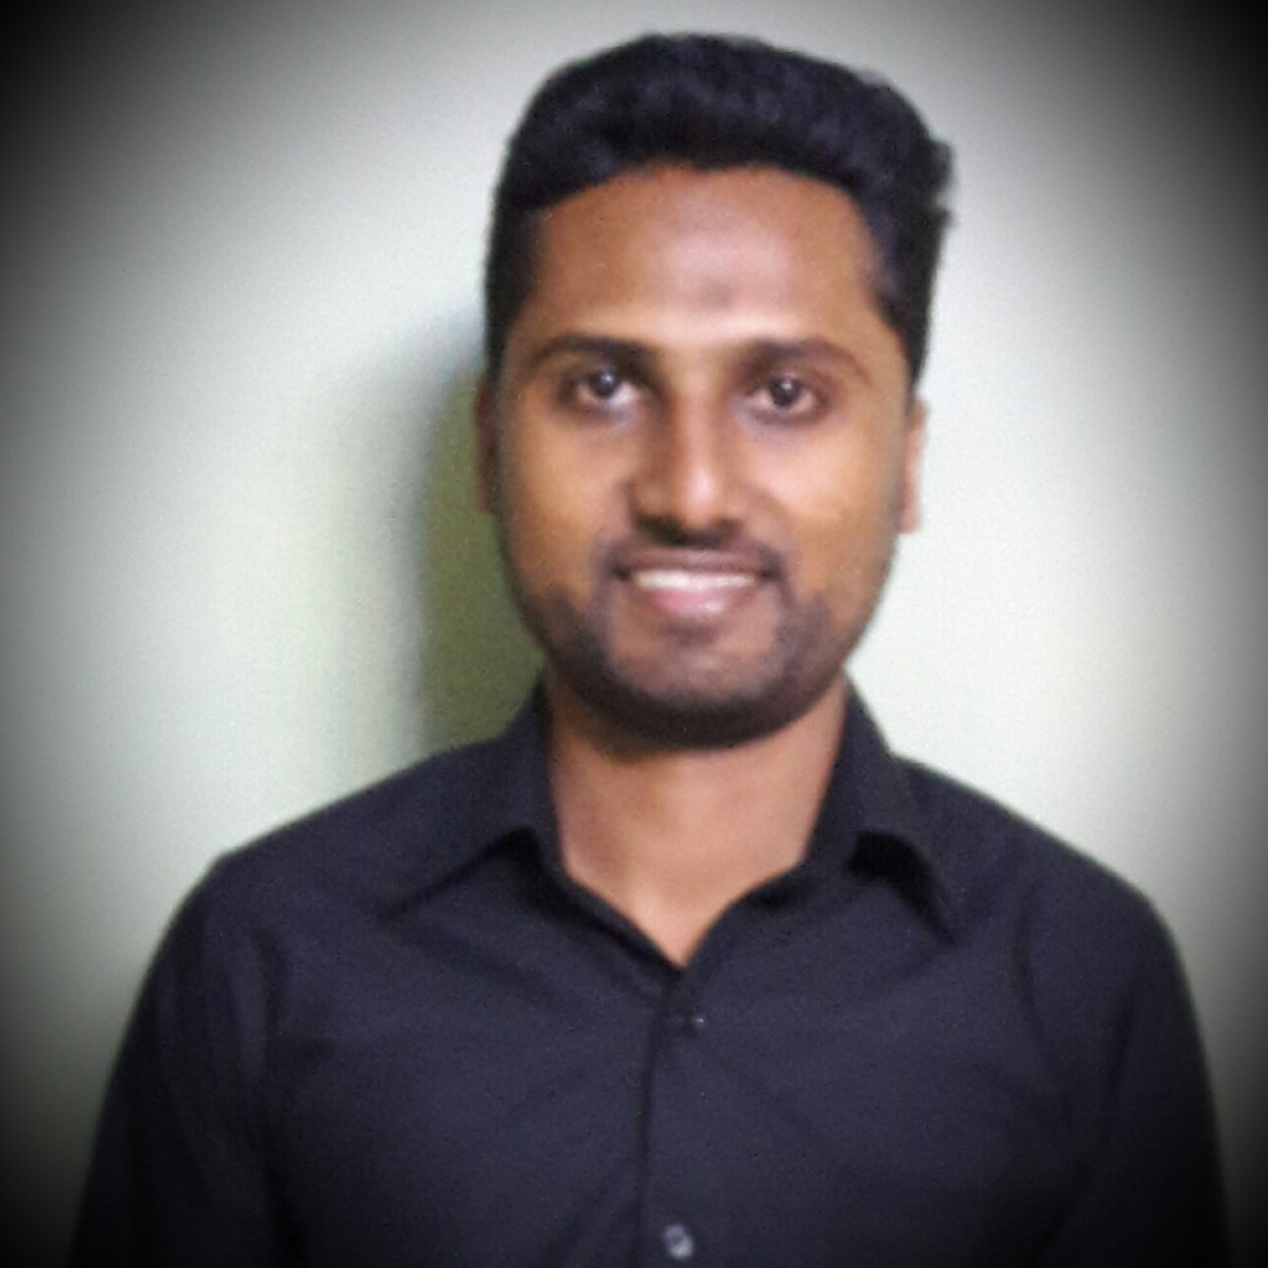
Experience
Areas of expertise
BI Developer ( Mar 2020 - Present)
Power BI report maintenance & development using Power BI. Use of Azure Data Factory, Azure Database and Azure Analysis services for data loading and transformation.
BI Developer ( Jan 2019 – Mar 2020)
SSRS report development. Use of Azure Data Factory, SQL Server Database and SQL Server Analysis services for data loading and transformation. ETL Developer - Tibco ( Dec 2016 – Dec 2018)
Interface development to integrate data from Workday into CSV / TXT files for external systems and integrate webpage data with SAP systems and vice versa.
ETL Developer - WebMethods ( Nov 2013 – Dec 2016)
Interface development to integrate data from SAP systems to SFDC and vice versa. Interface development to integrate data from SAP systems to SFTP and vice versa. Provide support on existing interfaces.
Technical
Azure DevOps
Azure Data Factory
Azure Database
Azure Analysis Services
MS SQL
DAX / M Language
Power BI
SSAS
SSRS
Tibco
WebMethods
Talend
Oracle SQL
Industries
Catering & Services
Aerospace - Electrical company
Pharmaceutical Company
Food production Company
Mining Company
Equipment Company
Textile Company
Nadhim ISSOP
BI Developer
Application Development Specialist Ebène, Mauritius.
Professional background
Bachelor of Science in Information and Communication Technologies.
More than 5 years of experience in the ETL domain and more than 2 years in BI.
Education
BSc(Hons) Information and Communication
Technologies
University of Mauritius, 2012

Slide 2

Current Experience
BI Developer
Skills & Technologies
Develop new Power BI reports and maintain existing ones.
Responsible to ensure that productivity and quality of work is respected for all deliverables.
Currently working on the automatic deployment of Power BI reports with their related components i.e., Azure Data Factory, Azure Database & Azure Analysis Services.
Participate in Technical workshops to provide solutions about issues.
Skills
Teamwork
Client facing
Analysis & solutions design
Problem Solving
Technical
Azure DevOps
Azure Data Factory
Azure Analysis Services
SQL Server Management Studio
Visual Studio
Git
Power BI

Slide 3
Past Experience
BI Developer – Accenture. Jan 2019 – Mar 2020
Data modelling using Power BI / MSBI.
Report creation in Power BI / using SSRS.
Tibco Developer – Accenture. Dec 2016 – Dec 2018
Developed interfaces to integrate data from workday into CSV / TXT files for external systems.
Developed interfaces to integrate webpage data using oracle database with SAP systems and vice versa using REST APIs, SFTP, webservices and SAP RFC functions.
Developed interfaces to integrate data in the form of documents from workday to PeopleDoc using webservices and PeopleDoc APIs.
Migration of existing Tibco 5.7 interfaces to Tibco 6.4.
Created technical documents for interfaces built.
Team management (around 10 persons).
WebMethods Support / WebMethods developer – Accenture. Nov 2013 – Dec 2016
Provide technical support for WebMethods interfaces on production.
Migration of existing SAP PI interfaces to WebMethods.
Built interfaces to integrate data from SAP to SFDC and vice versa.
Built interfaces to integrate transformed data from SFTP to SAP and vice versa.
Created forms and reports for users on Oracle.
Provided support for existing forms and reports.
Oracle Reports and form developer – Textile Company. Nov 2012 – May 2013
Created forms and reports for users on Oracle.
Provided support for existing forms and reports.

